Slide 1
Home Credit Default Risk
Predicting how capable each applicant is of repaying a loan
ISYE/CSE 6740 Computational Data Analysis, Fall 2022: Final Project Presentation

Slide 2





The Team
INTRODUCTION
Dr. Tuo Zhao
Instructor
ISYE/CSE 6740
PROBLEM FORMULATION
METHODOLOGY
RESULTS
Cheng-Wei (Wilson) Huang
Arnovi Moinuddin
Kavya N. Krishnan
Akpevwe Ojameruaye

Slide 3
Data Description
Base Models- LightGBM
Base Models- Linear
Data Processing
Feature Engineering
Arnovi Moinuddin
INTRODUCTION
Home Credit: broaden financial inclusion for unbanked population [1]
7 datasets utilized:
Application, Bureau Balance, Bureau, Credit Card Balance, Installments, Cash Balance, Previous Applications
Our Objective: predict likelihood of repayment to better distribute loans
Methodology:
Data Cleansing
Visualizations
Feature Selection
Model Fitting
Findings and Conclusions
PROBLEM FORMULATION
METHODOLOGY
RESULTS
[1] Home Credit Default Risk, Kaggle Competetions, 2018, URL: https://www.kaggle.com/competitions/home-credit-default-risk

Slide 4
Feature Research and Background
Arnovi Moinuddin
INTRODUCTION
Relevant Column Descriptions:
Training and Testing Splits
Column Name | Description
Ext_Source | Normalized score from external data source
Days_Birth | Client's age in days at the time of application
Days_ID_Publish | How many days before the application did client change the identity document with which he applied for the loan
COMMONAREA_MODE | Normalized information about building where the client lives
PROBLEM FORMULATION
METHODOLOGY
RESULTS

Slide 5
Data Preview
Base Models- LightGBM
Base Models- Linear
Data Processing
Feature Engineering
Akpevwe Ojameruaye
One of the complex problem types to apply machine learning is data preparation
Data Properties:
Dense
Heterogeneous
Time-varying
Response is unbalanced
Critical modeling aspect for this problem:
Clean dataset with features identified
Diverse machine learning algorithms (LightGBM, Logistic Regression )
INTRODUCTION
PROBLEM FORMULATION
METHODOLOGY
RESULTS

Slide 6
Data and Feature Selection
Akpevwe Ojameruaye
First big set of features that we used were the features that can be found in many datasets
These features employed various forms of aggregation on many-to-one tables and joined them with application features.
Feature Selection
Start with simple aggregates over SK_ID_PREV & SK_ID_BUREAU features for each SK_ID_CURR
Each of these choices were tested to identify the best boost in base models for these features
Featured selected were in descending order of importance
INTRODUCTION
PROBLEM FORMULATION
METHODOLOGY
RESULTS

Slide 7
EDA and Feature Selection Process
Akpevwe Ojameruaye
Data Exploration
Data Aggregation
Data Correlation
Data Cleansing
Feature Selection – Random Forest
INTRODUCTION
PROBLEM FORMULATION
METHODOLOGY
RESULTS

Slide 8
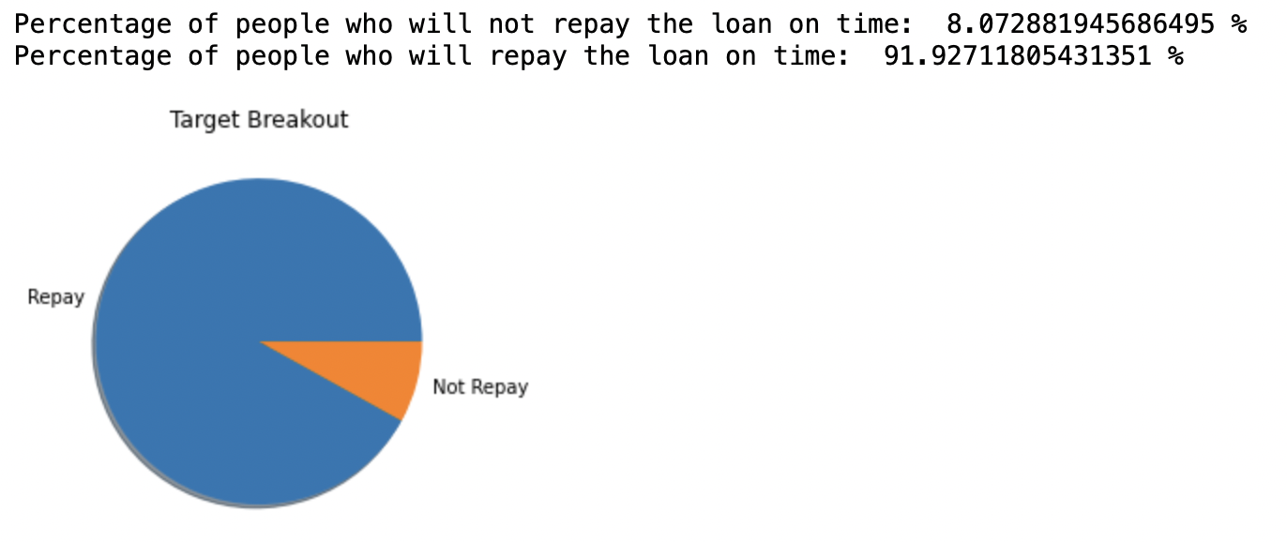
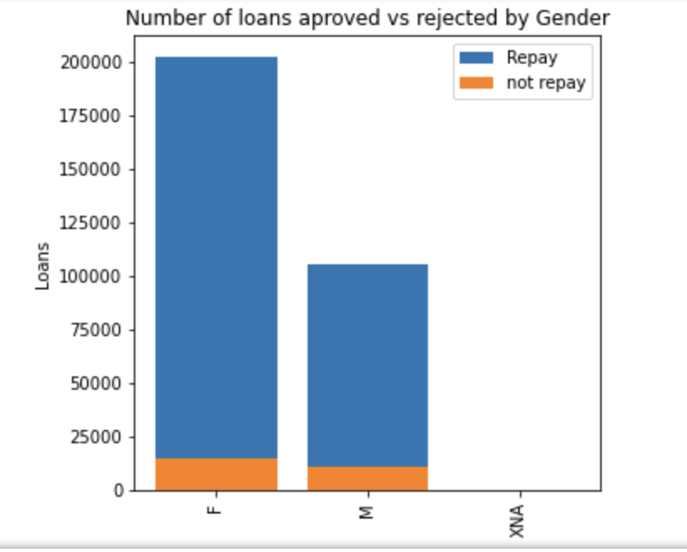
Data Exploration
Base Models- LightGBM
Base Models- Linear
Data Processing
Feature Engineering
Akpevwe Ojameruaye
INTRODUCTION
PROBLEM FORMULATION
METHODOLOGY
RESULTS

Slide 9
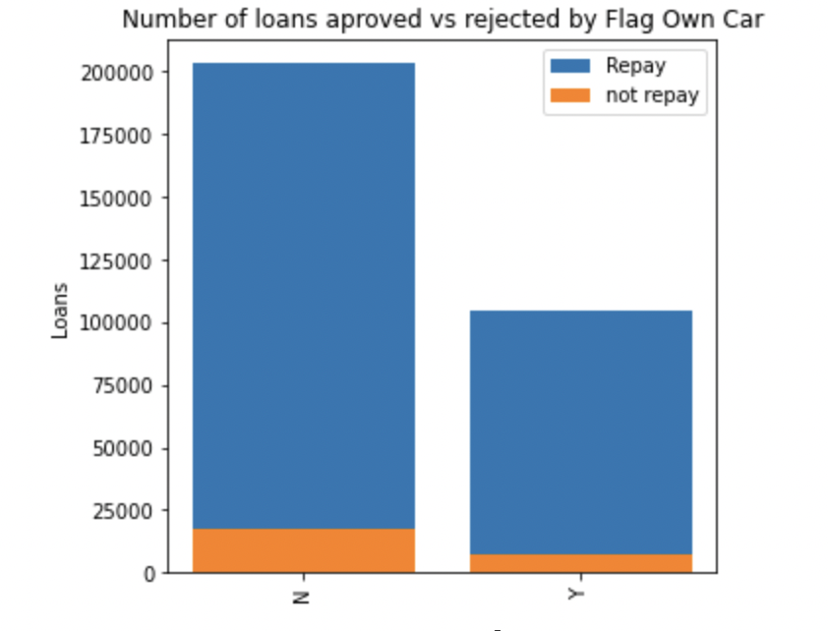
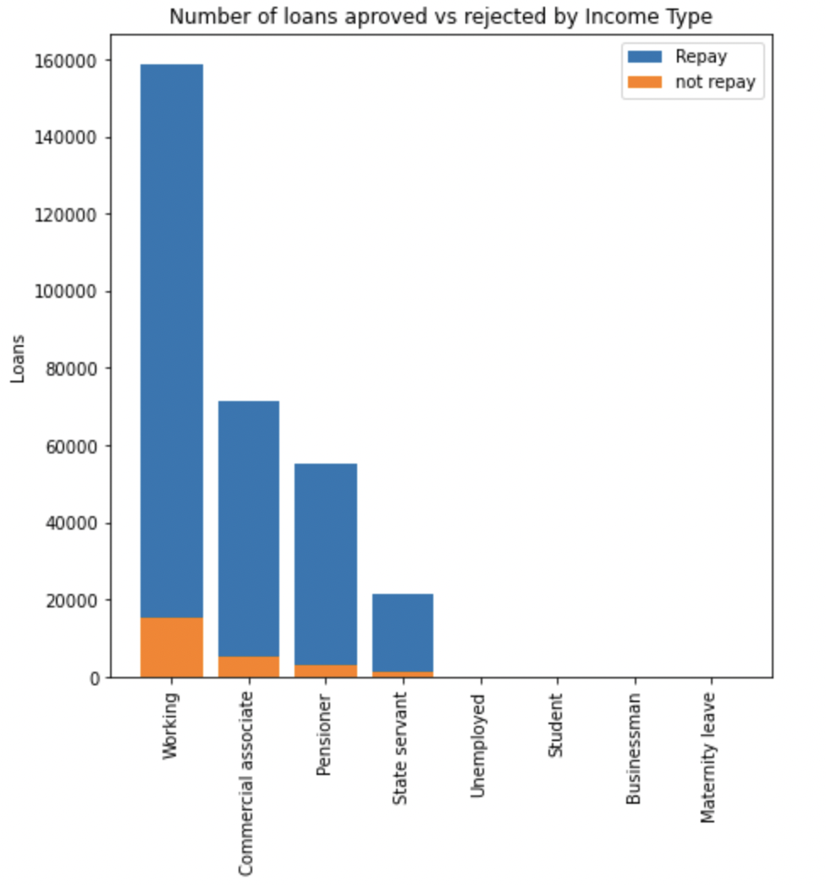
Data Exploration
Akpevwe Ojameruaye
INTRODUCTION
PROBLEM FORMULATION
METHODOLOGY
RESULTS

Slide 10
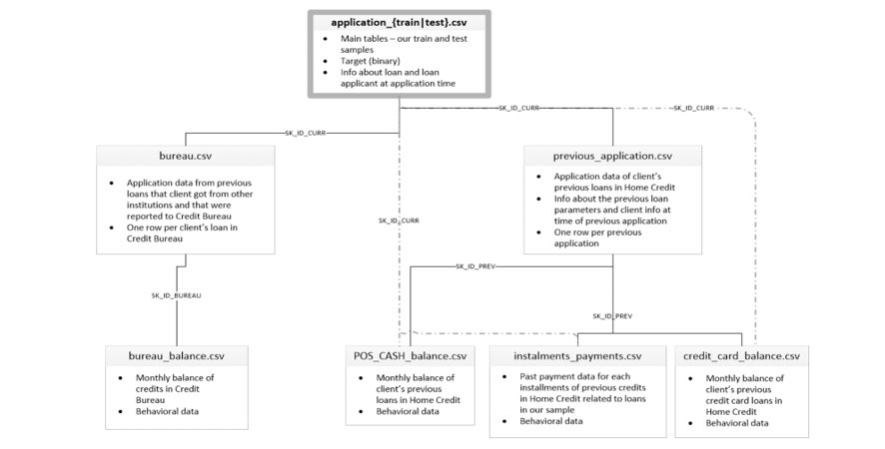
Data Aggregation - Schematic Diagram
Akpevwe Ojameruaye
INTRODUCTION
PROBLEM FORMULATION
METHODOLOGY
RESULTS

Slide 11
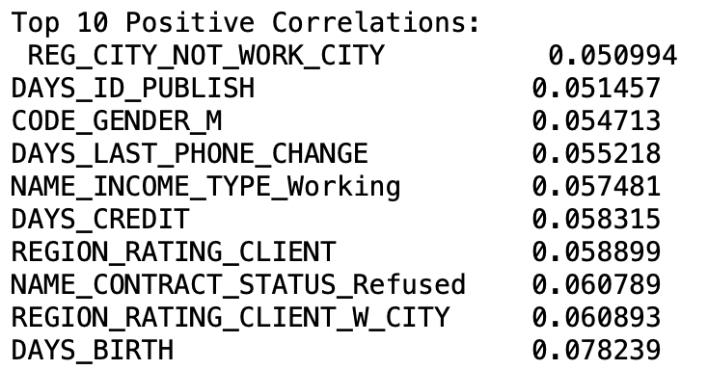
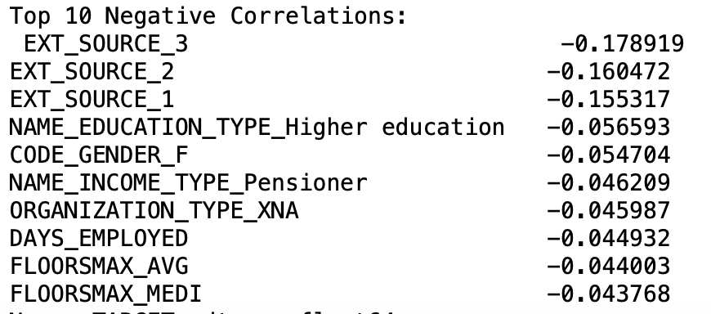
Data Correlation with Target
Akpevwe Ojameruaye
INTRODUCTION
PROBLEM FORMULATION
METHODOLOGY
RESULTS

Slide 12
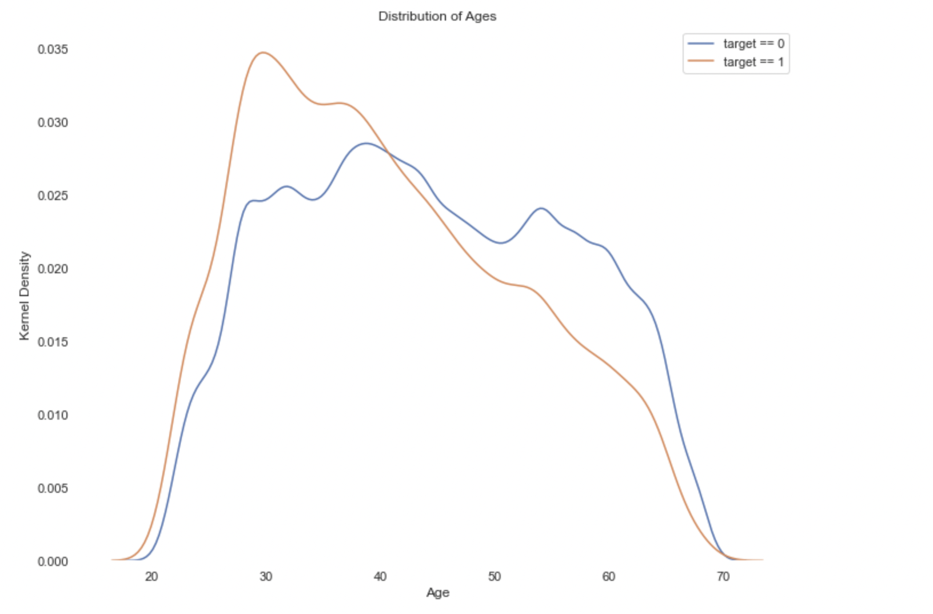
Data Correlation– Closer Look at Age Distribution
Akpevwe Ojameruaye
INTRODUCTION
PROBLEM FORMULATION
METHODOLOGY
RESULTS

Slide 13
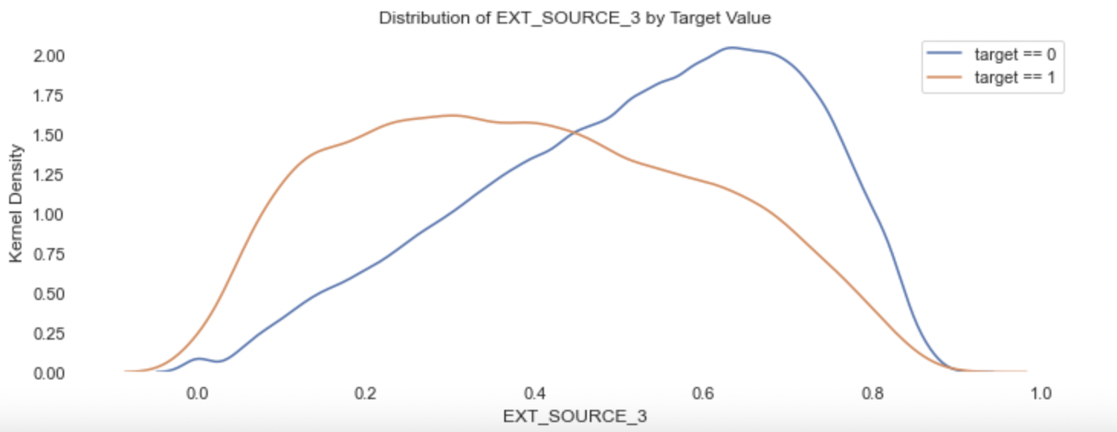
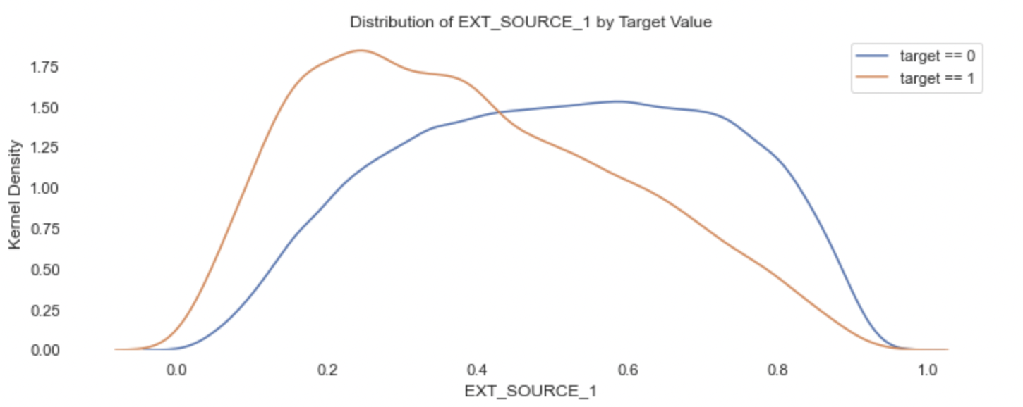
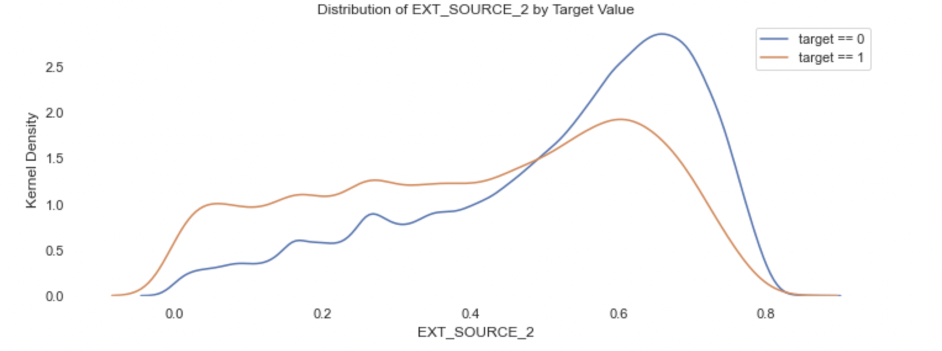
Data Correlation– Closer Look at Ext_Source
Akpevwe Ojameruaye
INTRODUCTION
PROBLEM FORMULATION
METHODOLOGY
RESULTS

Slide 14
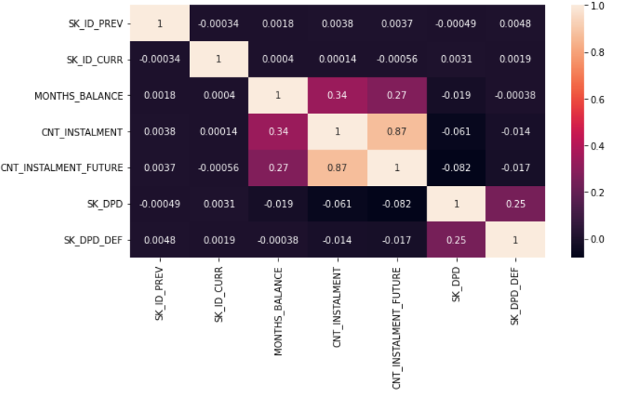
Correlation Heat Map: Pos_cash_balance
Akpevwe Ojameruaye
INTRODUCTION
PROBLEM FORMULATION
METHODOLOGY
RESULTS

Slide 15
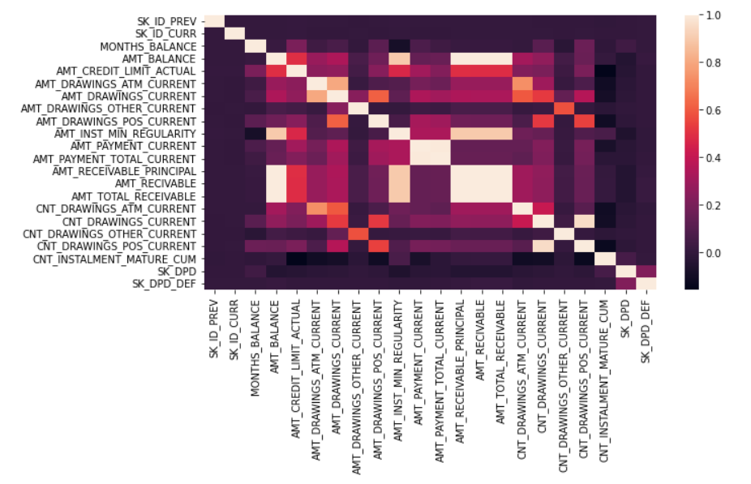
Correlation Heat Map: Credit Card Balance
Akpevwe Ojameruaye
INTRODUCTION
PROBLEM FORMULATION
METHODOLOGY
RESULTS

Slide 16
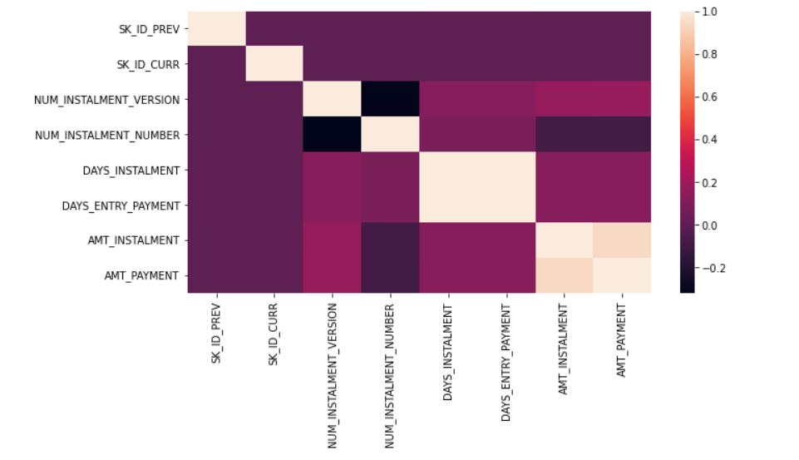
Correlation Heat Map: Payment Installments
Akpevwe Ojameruaye
INTRODUCTION
PROBLEM FORMULATION
METHODOLOGY
RESULTS

Slide 17
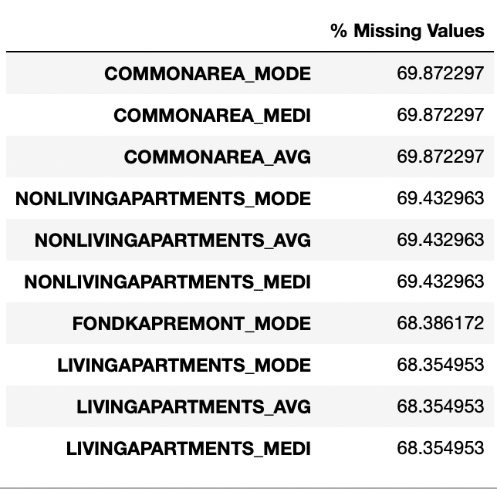
Data Cleansing – Missing Values
Akpevwe Ojameruaye
INTRODUCTION
PROBLEM FORMULATION
METHODOLOGY
RESULTS

Slide 18
Data Cleansing - Categorical Data
Akpevwe Ojameruaye
Column Count by Data Type
INTRODUCTION
Unique Value Count by Categorical Column
Data Type​ | Column Count​
Float64​ | 107​
Int64​ | 42​
Object​ | 36​
Column Name | Unique Value Count
Organization_Type | 58
Name_Goods_Category | 27
Occupation_Type | 18
Product_Combination | 17
Credit_Type | 14
PROBLEM FORMULATION
METHODOLOGY
RESULTS

Slide 19
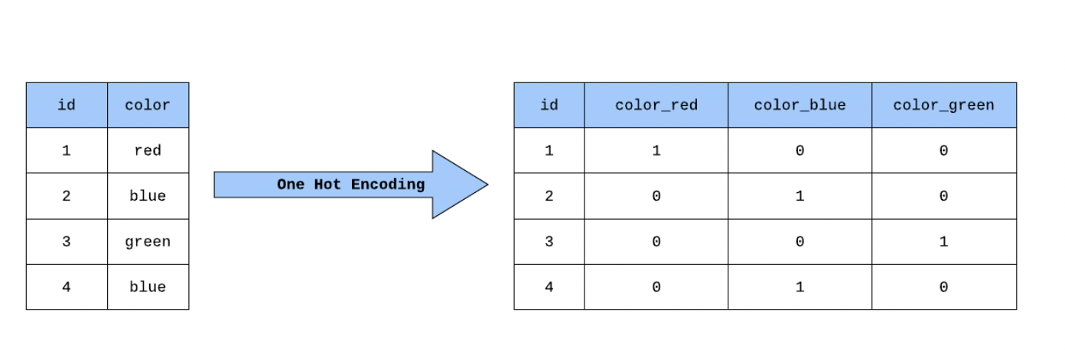
Data Cleansing – One-Hot Encoding
Akpevwe Ojameruaye
INTRODUCTION
We converted our categorical variables into binary variables by one-hot encoding.
PROBLEM FORMULATION
METHODOLOGY
RESULTS

Slide 20
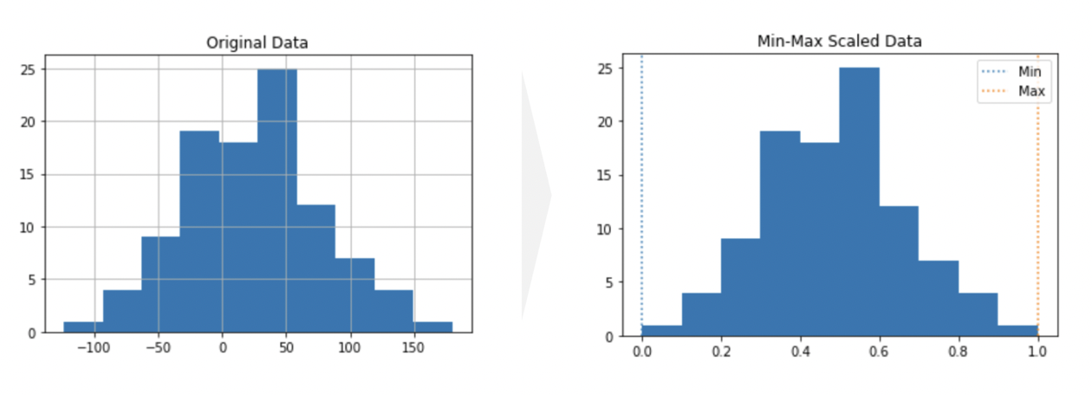
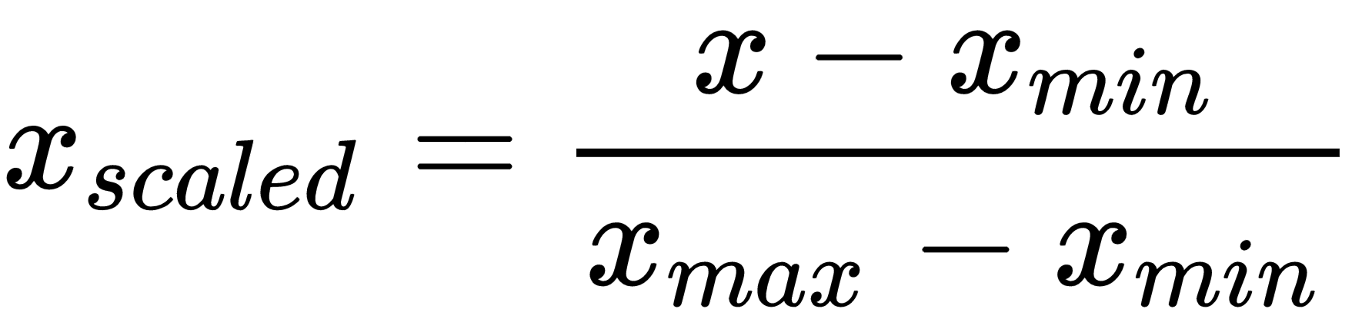
Data Cleansing – MinMax Standardization (0,1)
Akpevwe Ojameruaye
INTRODUCTION
PROBLEM FORMULATION
METHODOLOGY
RESULTS

Slide 21
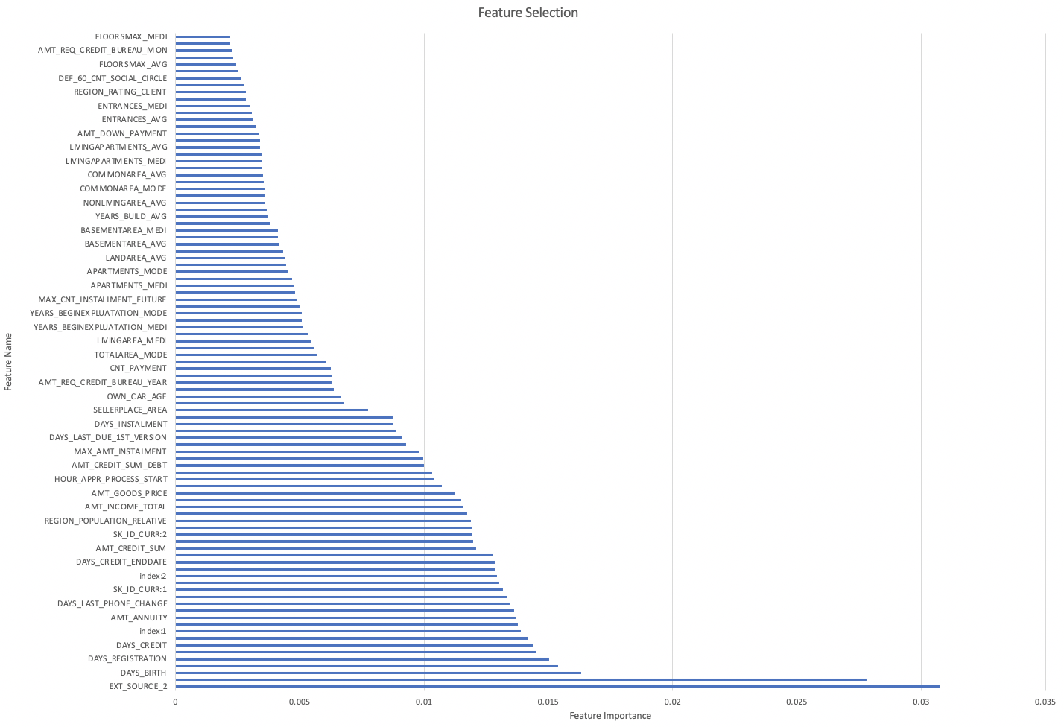
Data Cleansing: Feature Selection
Base Models- LightGBM
Base Models- Linear
Data Processing
Feature Engineering
Akpevwe Ojameruaye
INTRODUCTION
PROBLEM FORMULATION
METHODOLOGY
RESULTS

Slide 22
Transformed Data
Akpevwe Ojameruaye
Original Data Shape
One-Hot Coded Data Shape
Transformed Data Shape
INTRODUCTION
Rows | Columns
307511 | 198
Rows | Columns
3057511 | 455
Rows | Columns
307511 | 97
PROBLEM FORMULATION
Train-Test Data Split
METHODOLOGY
 | y_train | y_test
0 | 91.927 | 91.9266
1 | 8.0726 | 8.07336
 | Rows | Columns | Split %
X_train | 215257 | 97 | 70
X_test | 92254 | 97 | 30
RESULTS

Slide 23

LightGBM
Base Models- LightGBM
Base Models- Linear
Data Processing
Feature Engineering
Cheng-Wei (Wilson) Huang
INTRODUCTION
LightGBM is a gradient boosting framework that uses tree-based learning algorithms.
Advantages:
Faster training speed and higher efficiency.
Lower memory usage.
Capable of handling large-scale data.
PROBLEM FORMULATION
METHODOLOGY
RESULTS

Slide 24
Gradient Boosting
Cheng-Wei (Wilson) Huang
INTRODUCTION
Start with a single leaf (initial prediction)
Add a tree (restricted the size) based on residuals
Scale the tree's contribution with a learning rate
Add on another tree based on the new residuals
Repeat the process until the number of trees you ask for or fail to improve
PROBLEM FORMULATION
METHODOLOGY
RESULTS

Slide 25
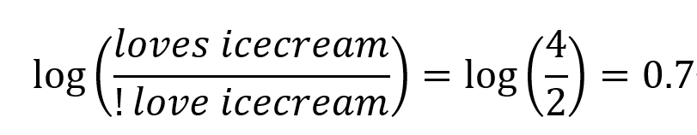
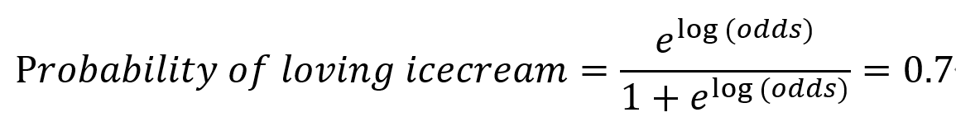
Gradient Boosting
Cheng-Wei (Wilson) Huang
Likes Popcorn | Age | Favorite Color | Loves Icecream
Y | 12 | Blue | Y
Y | 87 | Green | Y
N | 44 | Blue | N
Y | 19 | Red | N
N | 32 | Green | Y
N | 14 | Blue | Y
INTRODUCTION
PROBLEM FORMULATION
METHODOLOGY
Initial prediction
RESULTS

Slide 26
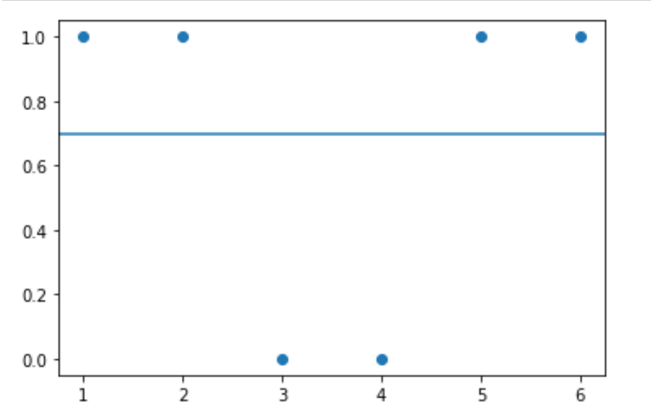
Gradient Boosting
Cheng-Wei (Wilson) Huang
Residuals=observe-predict
INTRODUCTION
Likes Popcorn | Age | Favorite Color | Loves Icecream | Residuals
Y | 12 | Blue | Y | 0.3
Y | 87 | Green | Y | 0.3
N | 44 | Blue | N | -0.7
Y | 19 | Red | N | -0.7
N | 32 | Green | Y | 0.3
N | 14 | Blue | Y | 0.3
PROBLEM FORMULATION
METHODOLOGY
Initial prediction
RESULTS

Slide 27
Gradient Boosting
Cheng-Wei (Wilson) Huang
Color=Red
INTRODUCTION
Likes Popcorn | Age | Favorite Color | Loves Icecream | Residuals
Y | 12 | Blue | Y | 0.3
Y | 87 | Green | Y | 0.3
N | 44 | Blue | N | -0.7
Y | 19 | Red | N | -0.7
N | 32 | Green | Y | 0.3
N | 14 | Blue | Y | 0.3
T
F
-0.7
Age>37
PROBLEM FORMULATION
T
F
0.3,-0.7
0.3,0.3,0.3
METHODOLOGY
RESULTS

Slide 28
Gradient Boosting
Cheng-Wei (Wilson) Huang
Color=Red
INTRODUCTION
Likes Popcorn | Age | Favorite Color | Loves Icecream | Residuals
Y | 12 | Blue | Y | 0.3
Y | 87 | Green | Y | 0.3
N | 44 | Blue | N | -0.7
Y | 19 | Red | N | -0.7
N | 32 | Green | Y | 0.3
N | 14 | Blue | Y | 0.3
T
F
-0.7
Age>37
PROBLEM FORMULATION
T
F
0.3,-0.7
0.3,0.3,0.3
METHODOLOGY
RESULTS

Slide 29
Gradient Boosting
Cheng-Wei (Wilson) Huang
Color=Red
INTRODUCTION
Likes Popcorn | Age | Favorite Color | Loves Icecream | Residuals
Y | 12 | Blue | Y | 0.3
Y | 87 | Green | Y | 0.3
N | 44 | Blue | N | -0.7
Y | 19 | Red | N | -0.7
N | 32 | Green | Y | 0.3
N | 14 | Blue | Y | 0.3
T
F
-3.3
Age>37
PROBLEM FORMULATION
T
F
-1
1.4
METHODOLOGY
RESULTS

Slide 30
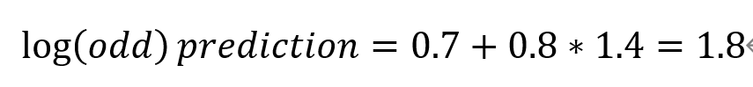
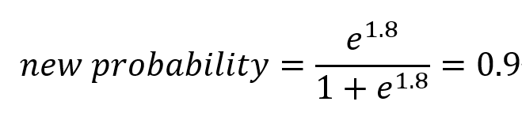
Gradient Boosting
Cheng-Wei (Wilson) Huang
Color=Red
INTRODUCTION
Likes Popcorn | Age | Favorite Color | Loves Icecream | Residuals
Y | 12 | Blue | Y | 0.3
Y | 87 | Green | Y | 0.3
N | 44 | Blue | N | -0.7
Y | 19 | Red | N | -0.7
N | 32 | Green | Y | 0.3
N | 14 | Blue | Y | 0.3
T
F
-3.3
Age>37
PROBLEM FORMULATION
T
F
-1
1.4
METHODOLOGY
RESULTS

Slide 31
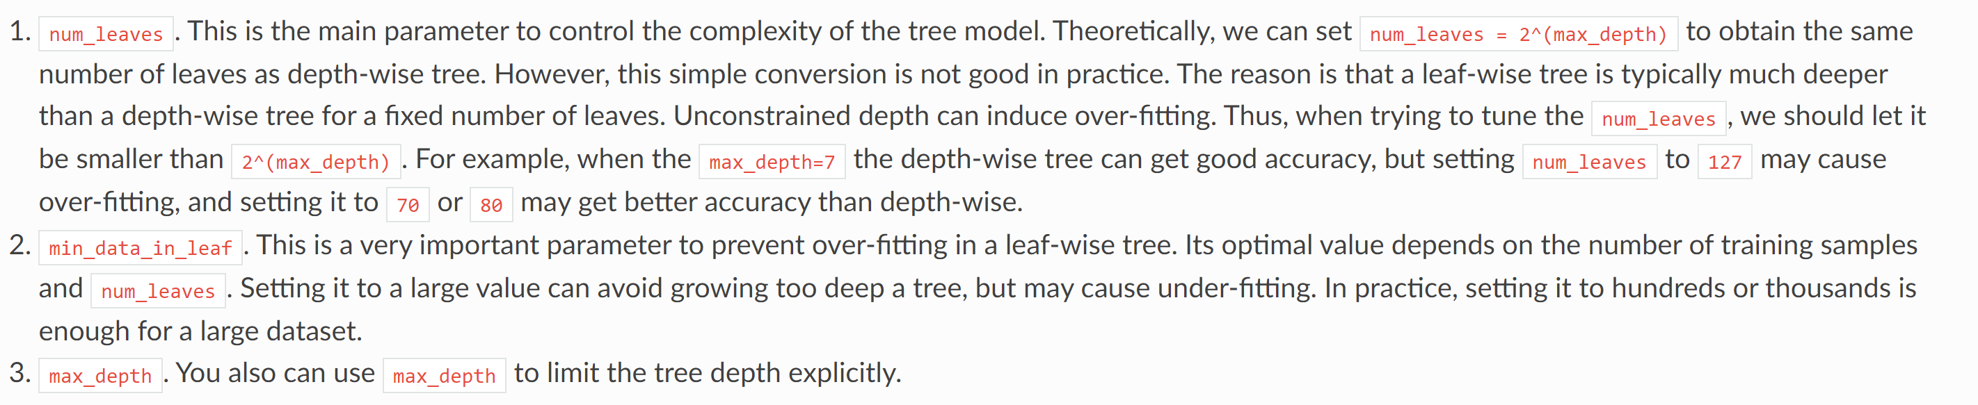
Lightgbm - Parameter
Cheng-Wei (Wilson) Huang
INTRODUCTION
PROBLEM FORMULATION
METHODOLOGY
RESULTS

Slide 32
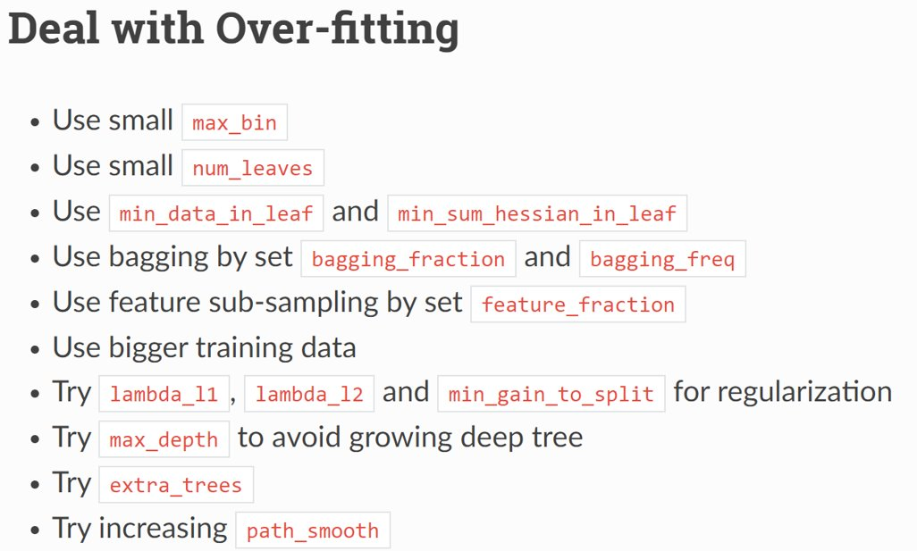
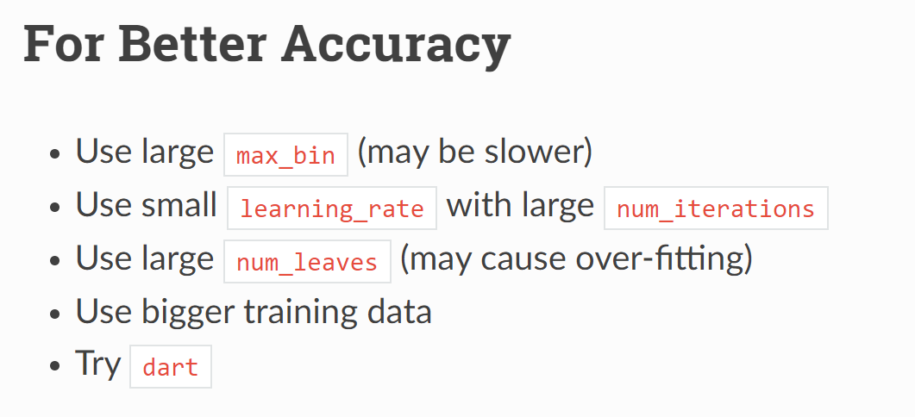
Lightgbm – Parameters Tuning
Cheng-Wei (Wilson) Huang
INTRODUCTION
PROBLEM FORMULATION
METHODOLOGY
RESULTS

Slide 33
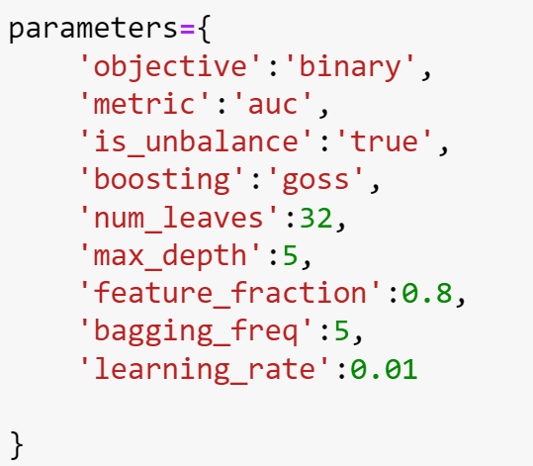
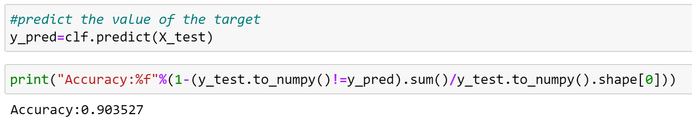
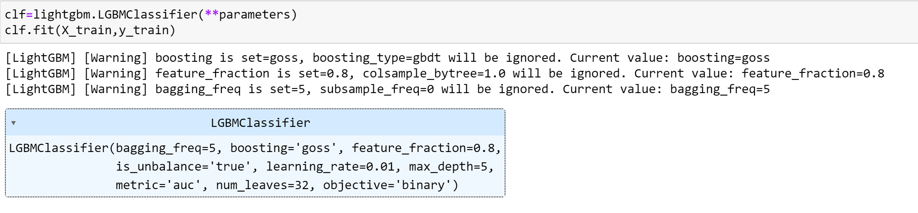
Lightgbm – Parameters Tuning
Cheng-Wei (Wilson) Huang
INTRODUCTION
PROBLEM FORMULATION
METHODOLOGY
RESULTS

Slide 34
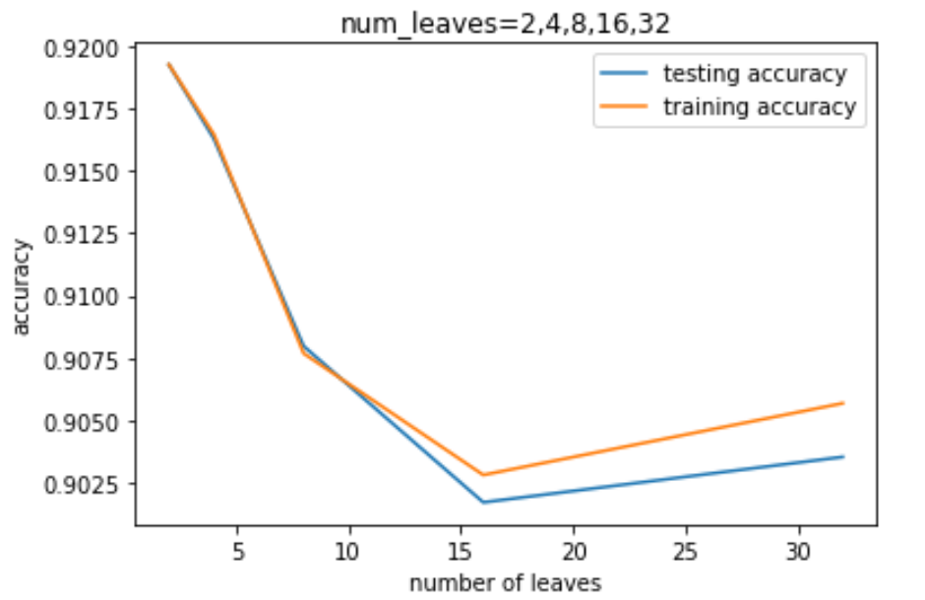
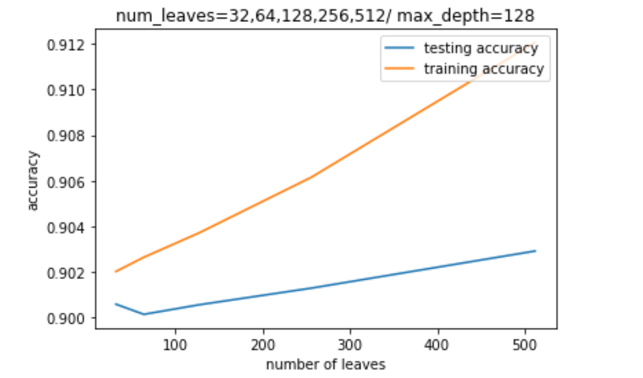
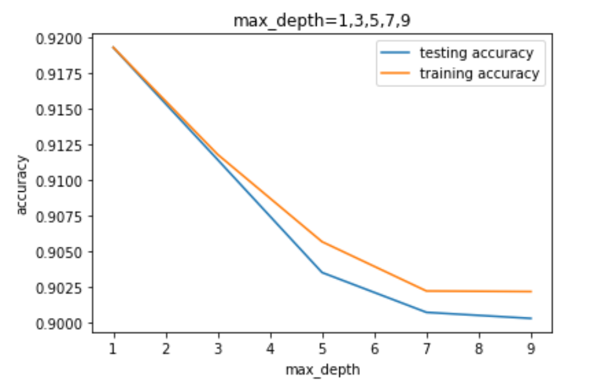
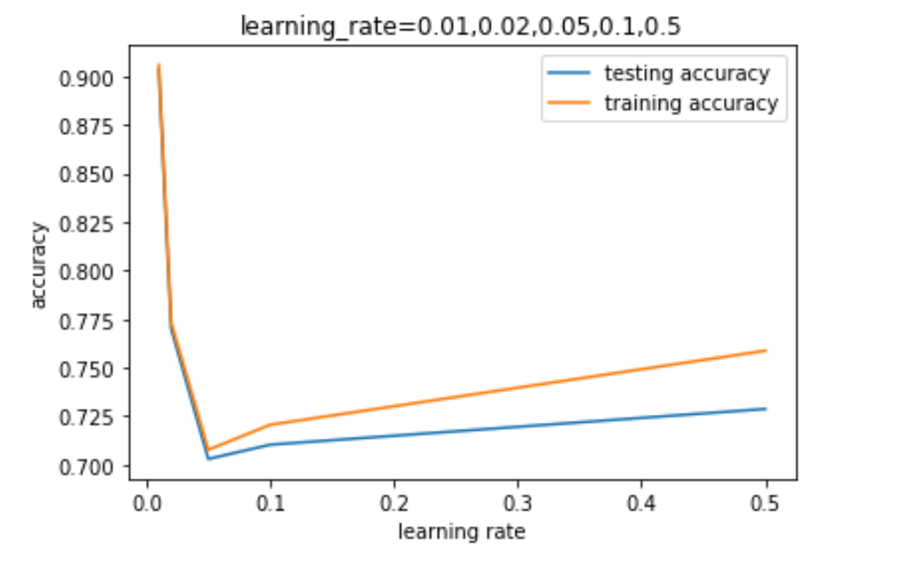
Lightgbm – Parameter Tuning
Cheng-Wei (Wilson) Huang
INTRODUCTION
PROBLEM FORMULATION
METHODOLOGY
RESULTS

Slide 35
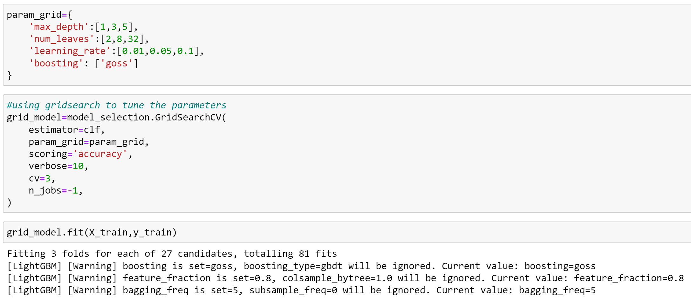
Lightgbm – Parameter Tuning
Cheng-Wei (Wilson) Huang
INTRODUCTION
PROBLEM FORMULATION
METHODOLOGY
RESULTS

Slide 36
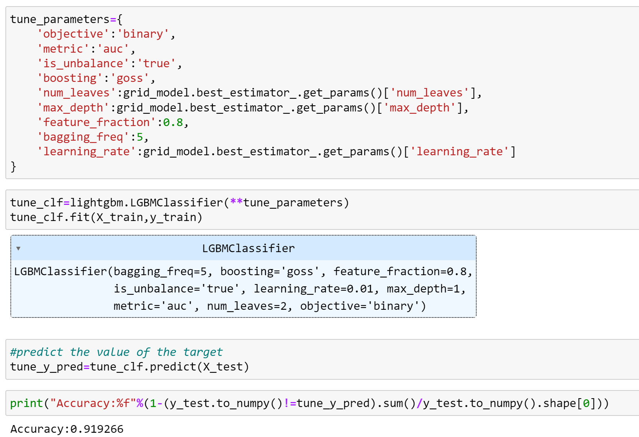
Lightgbm - Prediction
Cheng-Wei (Wilson) Huang
INTRODUCTION
PROBLEM FORMULATION
METHODOLOGY
RESULTS

Slide 37

Linear models
Base Models- LightGBM
Base Models- Linear
Data Processing
Feature Engineering
Kavya N. Krishnan
INTRODUCTION
Linear Regression and Logistic Regression is a linear approach of modelling relationship between target variables and explanatory variables
Logistic Regressions are used to classification task
On the contrary to LightGBM, Logistic Regression can not,
Handle large data, takes longer computational time and resources
Higher memory usage
PROBLEM FORMULATION
METHODOLOGY
RESULTS

Slide 38
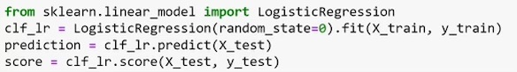
Logistic Regression Comparison and Results
Kavya N. Krishnan
INTRODUCTION
PROBLEM FORMULATION
METHODOLOGY
 | Lightgbm | Logistic Regression
Time | 43.6628 sec | 44.9523 sec
Accuracy | 0.919266 | 0.919266
AUC | 0.7529 | 0.5026
RESULTS

Slide 39
Key Outcomes
Kavya N. Krishnan
Base Models- LightGBM
Base Models- Linear
Data Processing
Feature Engineering
Processed, cleaned, transformed
Selected features were identified based on targets and trained/tested
LightGBM boosting base algorithm as implemented to receive an AUC 0.75
Logistic regression models were tested and an AUC of 0.50 was obtained
INTRODUCTION
PROBLEM FORMULATION
METHODOLOGY
RESULTS

Slide 40
Next Steps
Kavya N. Krishnan
INTRODUCTION
Resources from lectures combined with techniques from literature produced a high-fidelity model
A better method to restrict the feature set can boost the AUC scores and increase correction of the data w.r.t. target
Testing various other models like XGBoost, CatBoost would be interesting to compare the boosting model performances against Linear models
PROBLEM FORMULATION
METHODOLOGY
RESULTS

Slide 41
Conclusions
Kavya N. Krishnan
INTRODUCTION
Resources from lectures combined with techniques from literature produced a high-fidelity model with a good AUC
There are lot of grounds to be covered with regards to implementing other boosting techniques
PROBLEM FORMULATION
METHODOLOGY
RESULTS

Slide 42
Home Credit Default Risk
Predicting how capable each applicant is of repaying a loan
Any Questions?
Thank you!
Cheng-Wei (Wilson) Huang
Arnovi Moinuddin
Kavya N. Krishnan
Akpevwe Ojameruaye

